Slide 1
CAMPSYS
User Manual
OPERATION MODULE
V1.0

Slide 2
CONTENT
MAIN INTERFACE
STAFF RECORD
How to add new record?
How to edit record?
Additional Record
How to delete record?
View Staff Detail
SEARCH
EXPORT

Slide 3
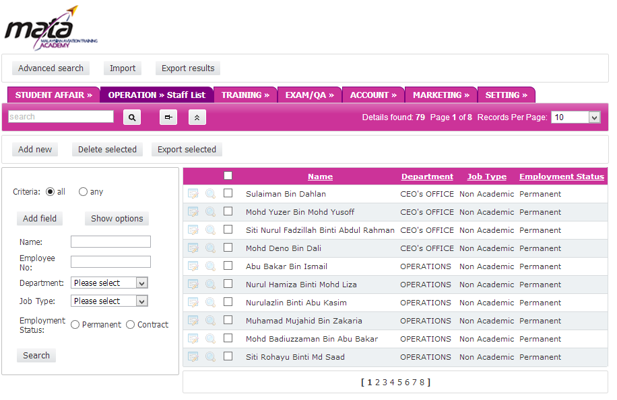
MAIN INTERFACE
QUICK SEARCH – Find student name quickly
DELETE -Permenantly delete selected record
EXPORT- Export selected records to Excel, Word etc
RECORD PER PAGE– Limit the record list per page
CHECKBOX – Can be selected for action. For example: Delete, Export
ADD NEW-
Add new record
SHOW OPTIONS-
Show range/interval input seach
ADD FIELD- Additional Search filter
VIEW DETAIL
Detail of Student Records
EDIT RECORD-Edit selected record details
SEARCH PANEL- Search particular records
PAGINATION- Navigate to other records page

Slide 4
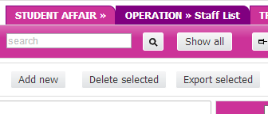
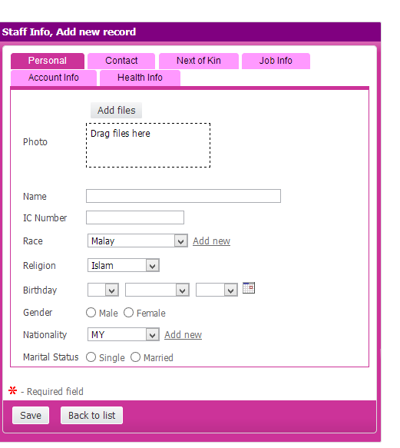
Staff Record: How to add new staff?
1
Click Add New button
2
Fill in all relevant field in each tab. (Personal, Contact, Next of Kin, Job Info, Account Info & Health Info) Note: The asteric symbol is the compulsory field.
Click SUBMIT to save the record.
3

Slide 5
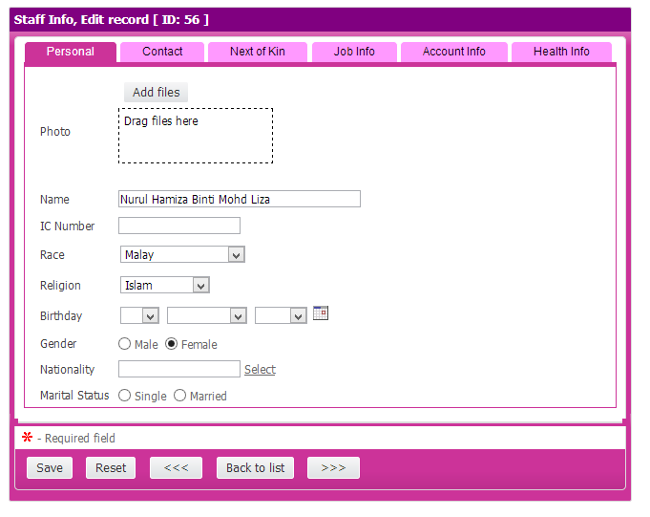
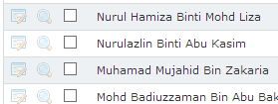
Staff Record: How to edit staff record?
1
Click EDIT button at staff list
2
Click SAVE to update record.
3
Click >>> if want to edit next record

Slide 6
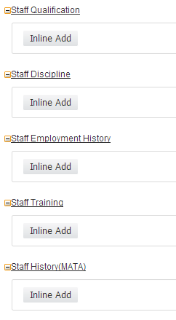
Staff Record: Additional Record
1
Click EDIT button at staff list
2
Click Inline Add for additional record selected staff

Slide 7
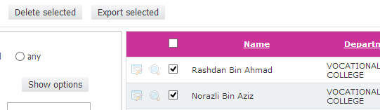
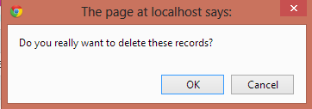
Staff Record: Delete
Tick the CHECKBOX at the record to be remove
1
3
Click OK to confirm delete
2
Click DELETE SELECTED

Slide 8
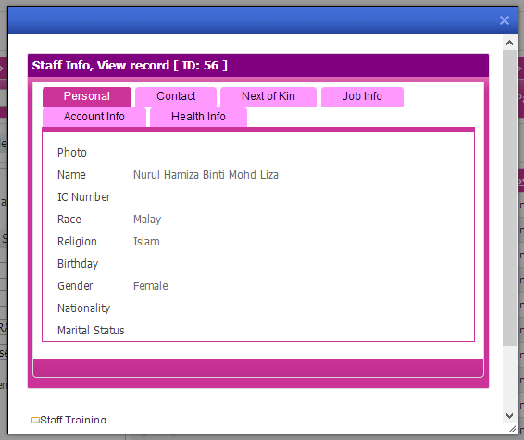
Staff Record: View Detail
1
Click VIEW at staff list

Slide 9
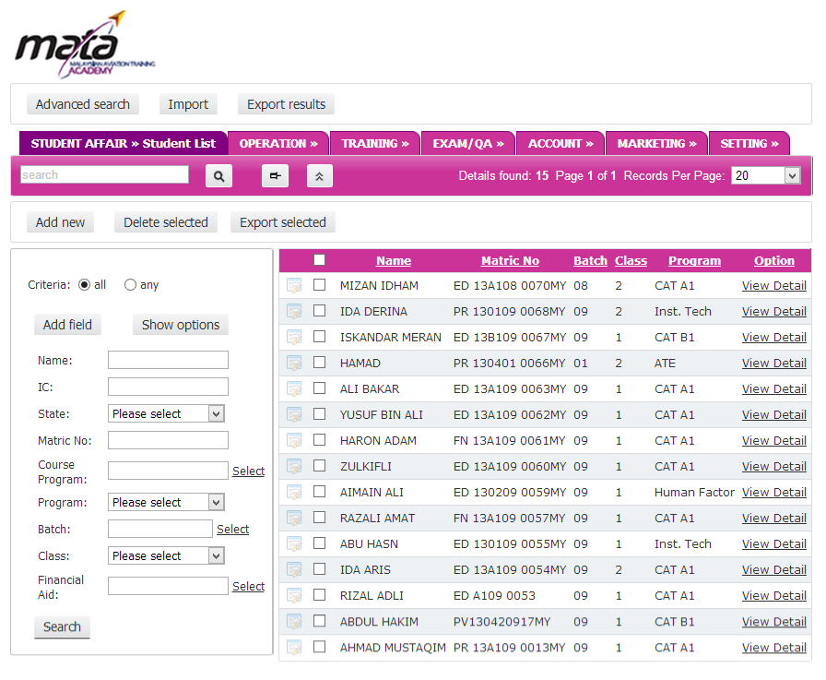
SEARCH: Overview
3
QUICK SEARCH – Find name quickly
2
HIDE SEARCH OPTIONS
Toggle hide/show the search panel
5
4
SHOW OPTIONS-
Show range/interval input seach
ADD FIELD- Additional Search filter
1
SEARCH PANEL- Search area with important field

Slide 10
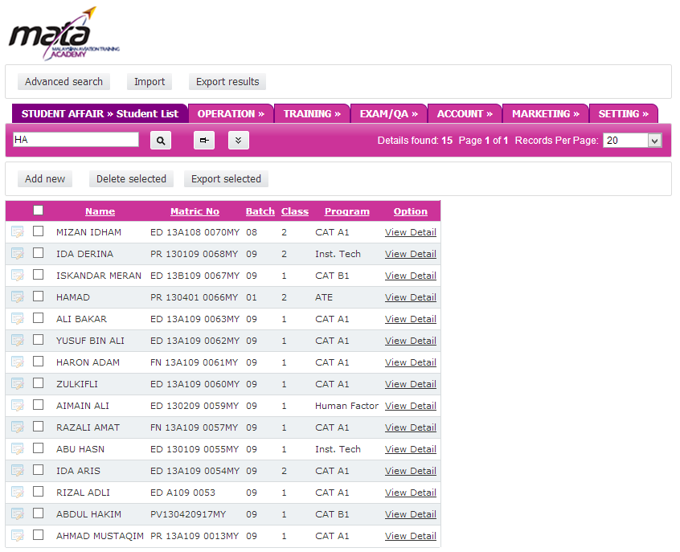
SEARCH
2
HIDE SEARCH OPTIONS
Toggle hide/show the search panel
2
1
SEARCH PANEL- Search area with common field. Type in one of those field and click SEARCH to proceed.

Slide 11
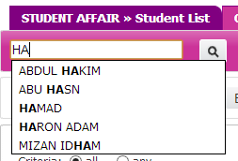
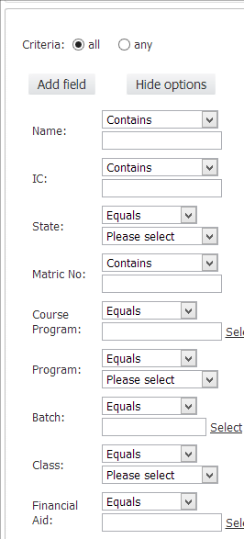

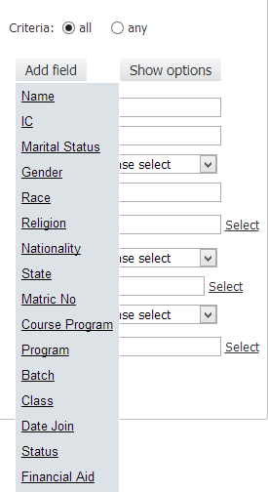
SEARCH:
3
QUICK SEARCH – Find name quickly
SHOW OPTIONS-
Show range/interval input seach
4
5
ADD FIELD- Additional Search filter which not in search panel

Slide 12
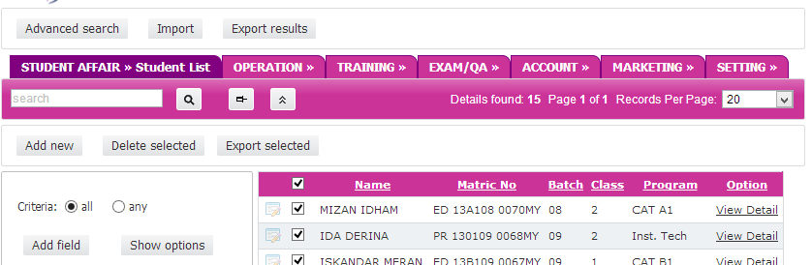
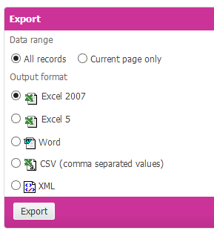
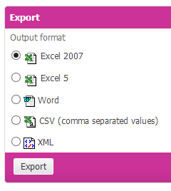
EXPORT
You can export record list to many format like EXCEL, WORD , CSV..
1
EXPORT RESULT- To export current page or all records
2
EXPORT SELECTED- To export selected data only

